Slide 1

Online Betting System
Fantasy buzz

Slide 2
Brief Defination
The product Fantasy Buzz is meant for all cricket fans increasing their excitement and showing their expertise for selection of players.
In this application , Admin manages events such as creation,edition and deletion.After the event is completed, Admin gives points to the players and result is calculated based on given points.
In this application, Users create accounts, creates his team for the generated event by the user and gets the result after it is completed.
This application is only meant for entertainment purpose and adding more interest to cricket.

Slide 3
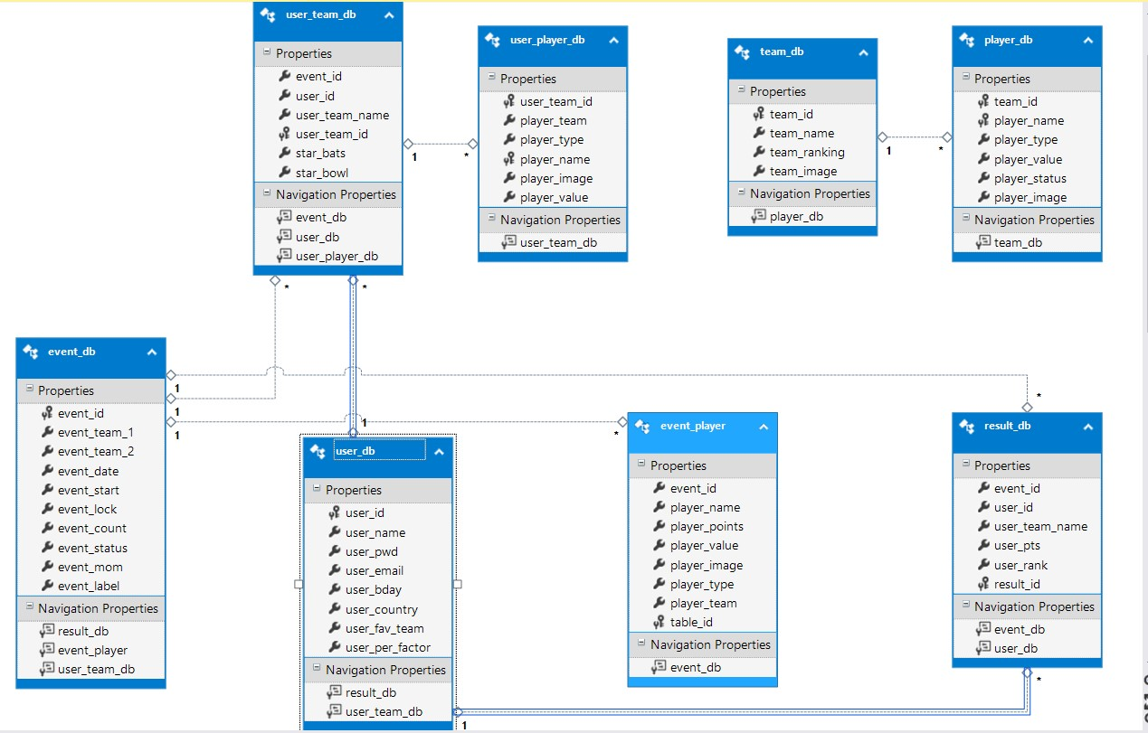
Database Design

Slide 4
Description of design Pages
login.aspx
Contains Login control for Login ID and password and a button for generate request.Also contains sign up button for new user sign up.
login.aspx.cs
Checks the constrains in database, if matches, redirects to corresponding pages otherwise show error message.

Slide 5
Description of design Pages
Signup.aspx
It contains CreateUserWizard for new users sign in.
Signup.aspx.cs
It contains code to insert the entered value in user database.
Extradetails.aspx
It contains controls extra details to insert by user.User can ignore this values also.
Extradetails.aspx.cs
It contains code to enter the details in user database.

Slide 6
Description of design Pages
Home.aspx
It contains table which displays all the events(Upcoming,Ongoing and Resulted).User can enter into new event,view his created team in ongoing events and also view results for his participated events.
Home.aspx.cs
It contains code for retrieving values from database for all the events.

Slide 7
Description of design Pages
Team.aspx
It contains team details,all the players available for the event and selection of star players.Also it includes selected players if any by the user.Also it validates the team as the user selects.
Team.aspx.cs
It contains the code for entering selected player in the database,
Code to remove player if cancelled by the user and conditions to check the validation of the selected team.

Slide 8
Description of design Pages
View.aspx
It displays the team selected by the user from team.aspx .It also contains delete and edit options to manage the team.It contains link to cricbuzz to view live scores for the event.
View.aspx.cs
It contains code to retrieve team of that user from yhe database.If edit button is clicked, user is redirected to team.aspx to make changes.If delete button clicked to delete.aspx where team is deleted.
Delete.aspx
It displays label that the team is deleted.
Delete.aspx.cs
It contains code which deletes the team and button to redirect user to home page.

Slide 9
Description of design Pages
Result.aspx
It contains user’s selected players with respecyive points when results are generated by admin.It also contains buttin to allow user to see top results.It also displays user’s total points and rank.
Result.aspx.cs
It contains code to for displaying results from the database from the selected event.

Slide 10
Description of design Pages Admin Pages
Ahome.aspx
User is redirected here if he is admin user.Here he can add new events,request to add players to event,request for inserting points for players for locked events and see results for finished events.
Ahome.aspx.cs
It contains code to retrieve events from database,add new event if generated by admin and redirection to other pages if selected by admin.

Slide 11
Description of design Pages Admin Pages
Players.aspx
It contains all the available players in the application for the teams participating in the event.Admin can add each player to event if he is available for particular match and aslo can add new players.
Players.aspx.cs
It contains code to add the selected player to that event,aslo contains code if admin wants to add new player.

Slide 12
Description of design Pages Admin Pages
Points.aspx
It contains all the players that were available for that event.Here admin can insert points for that player as per the scoreboard of that match.It also contains option to select man of the match for that event.
Points.aspx.cs
It contains code add points for each player to the database.After inserting points user is redirected to calcresult.aspx page to calculate results of each user.

Slide 13
Description of design Pages Admin Pages
Calcresult.aspx
It calculates result for each player and displays the result table.
Calcresult.aspx.cs
It contains code to calculate result of each player registered in the event and then displays results from the database.

Slide 14
Description of design Pages Class Files
Playerload.cs
It contains code to load players which are available for the event to the control in the page which called this class file’s method.
Manageevents.cs
It contains code to change event status as required.It makes event locked if the event is started which makes team creation unavailable for user.
And repectively make changes in the database.

Slide 15
Secuity Aspects Authentication & Authorization
Forms based authentication is used in the project.
Aspnetdb is used to register new user and validate user from login control.
All user pages are unauthorized for illegal access without login.
All admin pages are authorized for any illegal access by any user or from unregistered user.Admin can also access admin pages only after logging in from login control.
User is logged out from home page by clicking logout link button which makes his information secure from any other access in same browser.

Slide 16
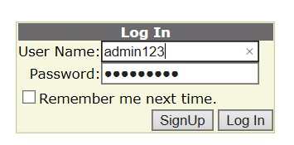
Output Screenshots Login page
Login Page is same for admin and users.

Slide 17
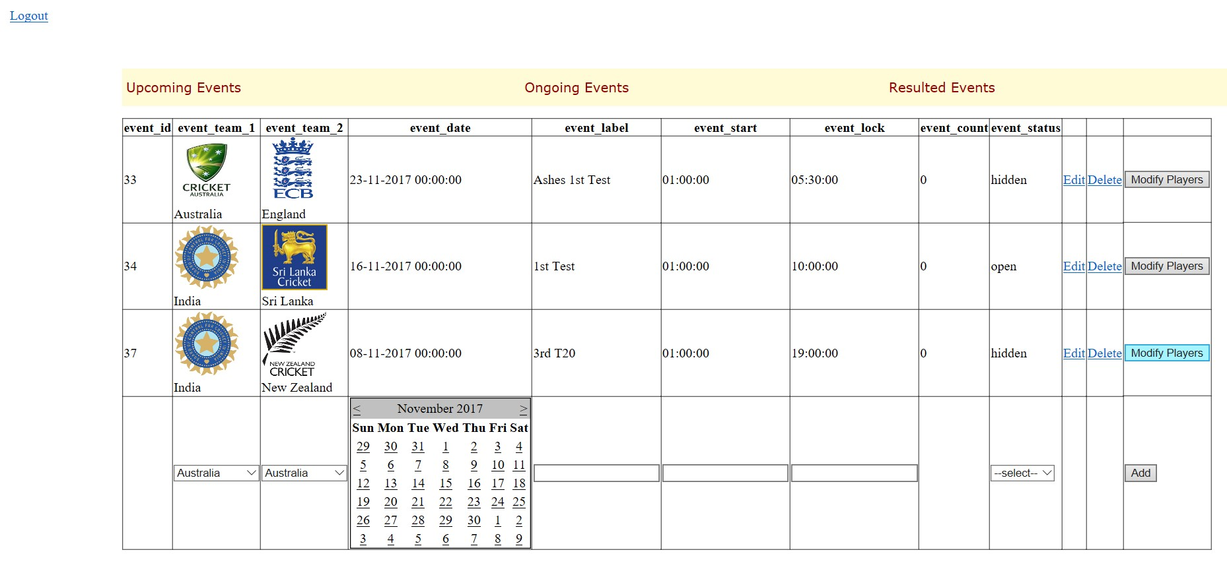
Output Description Admin Home

Slide 18
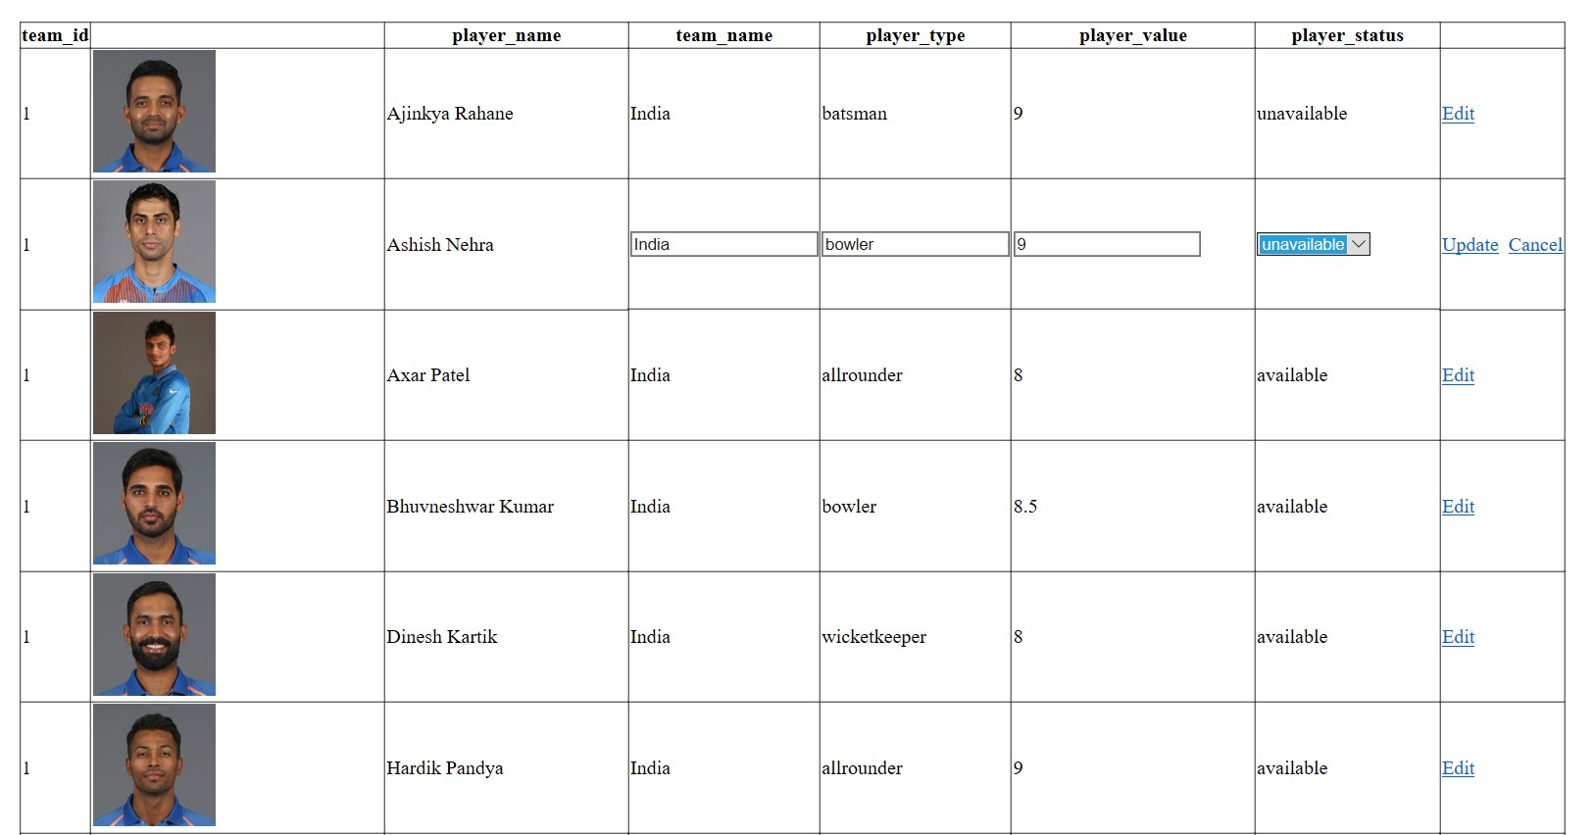
Output Description Admin – Players.aspx

Slide 19
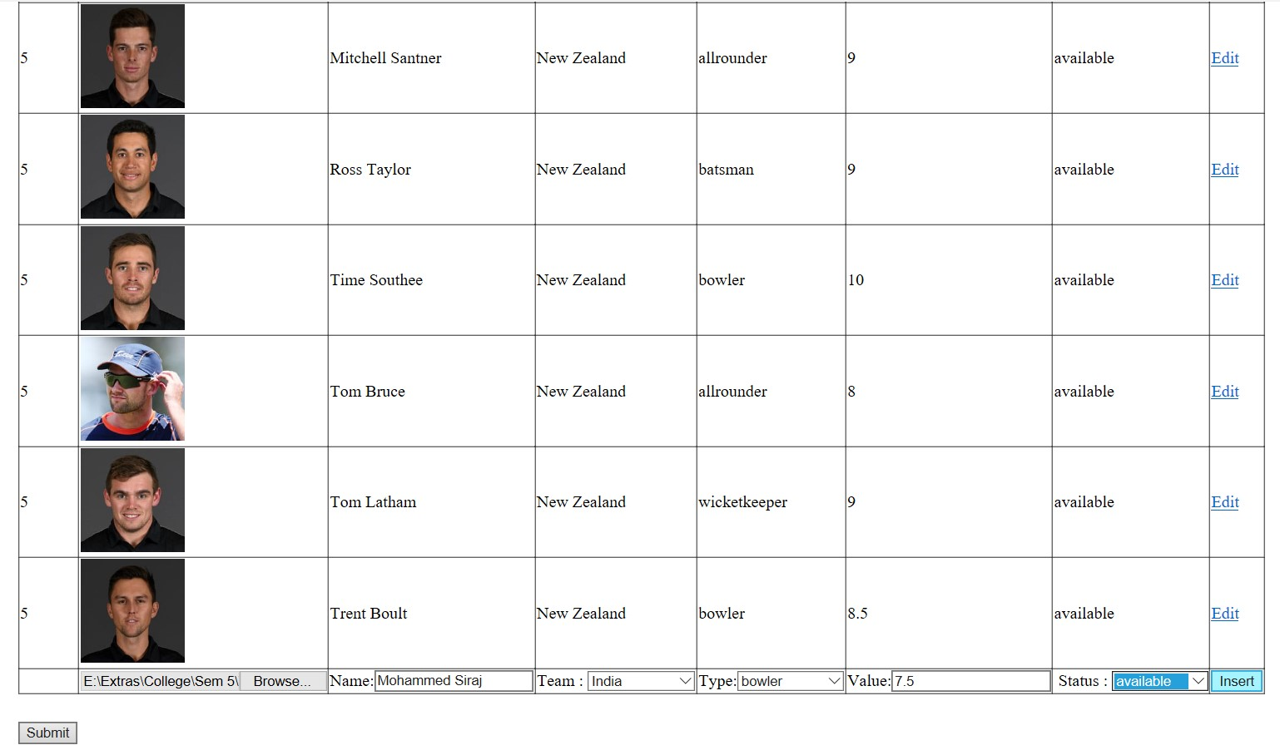
Output Description Admin – Players.aspx(Cont.)

Slide 20
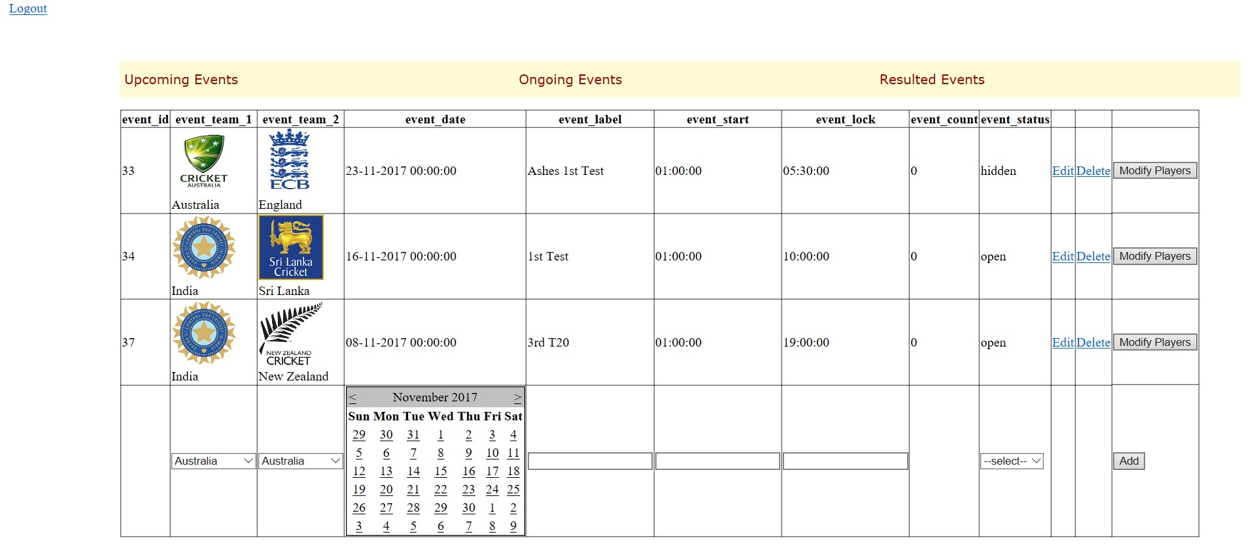
Output Description Admin Home (After submitting players)

Slide 21
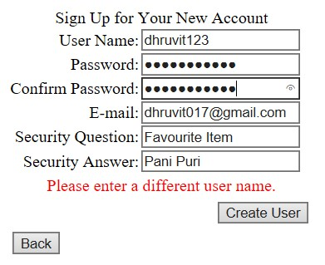
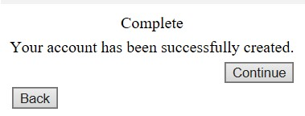
Output Description SignUp

Slide 22
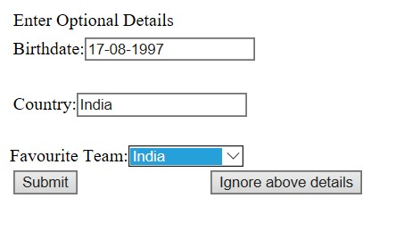
Output Description Extra Details

Slide 23
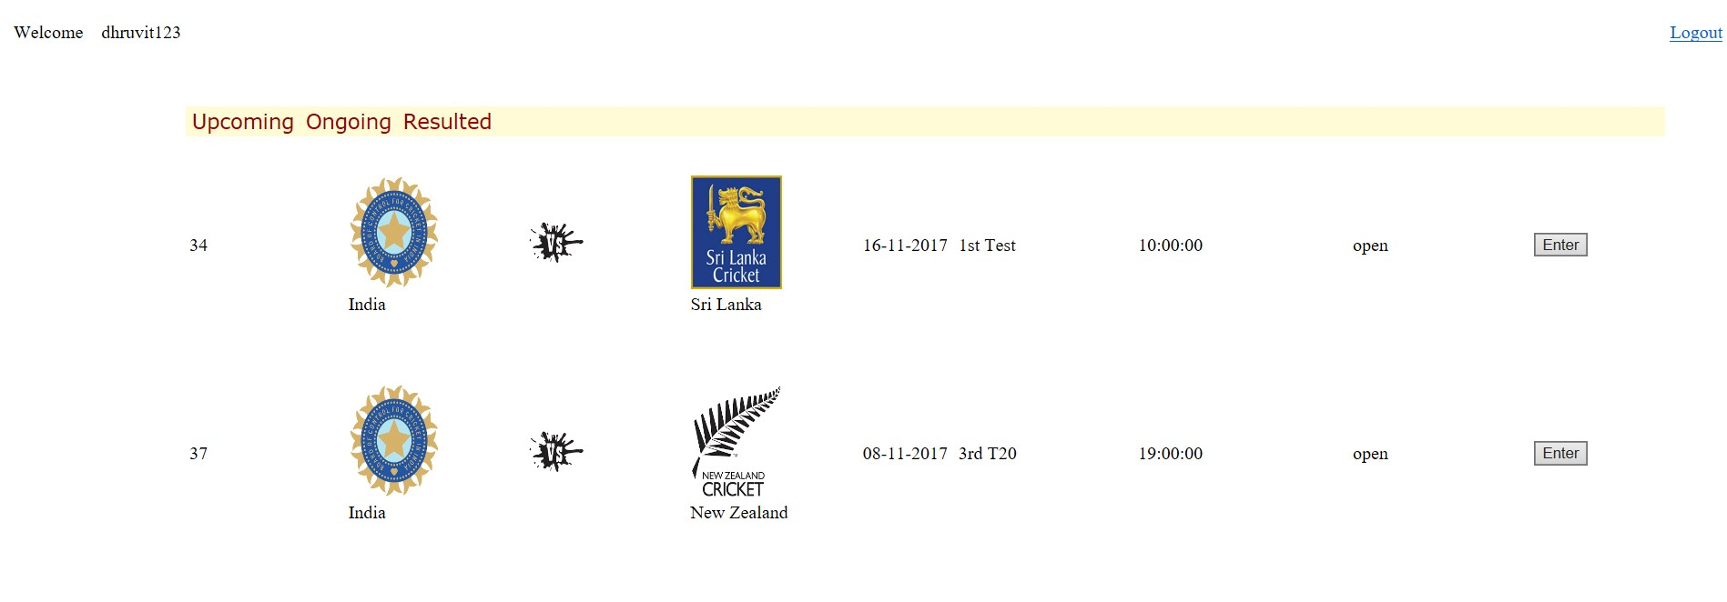
Output Description User Home

Slide 24
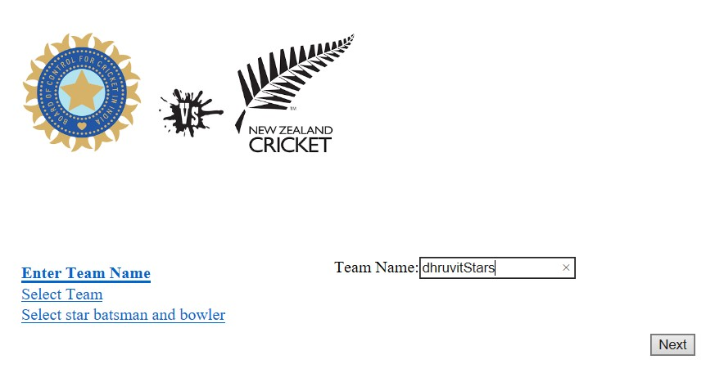
Output Description Team (1)

Slide 25
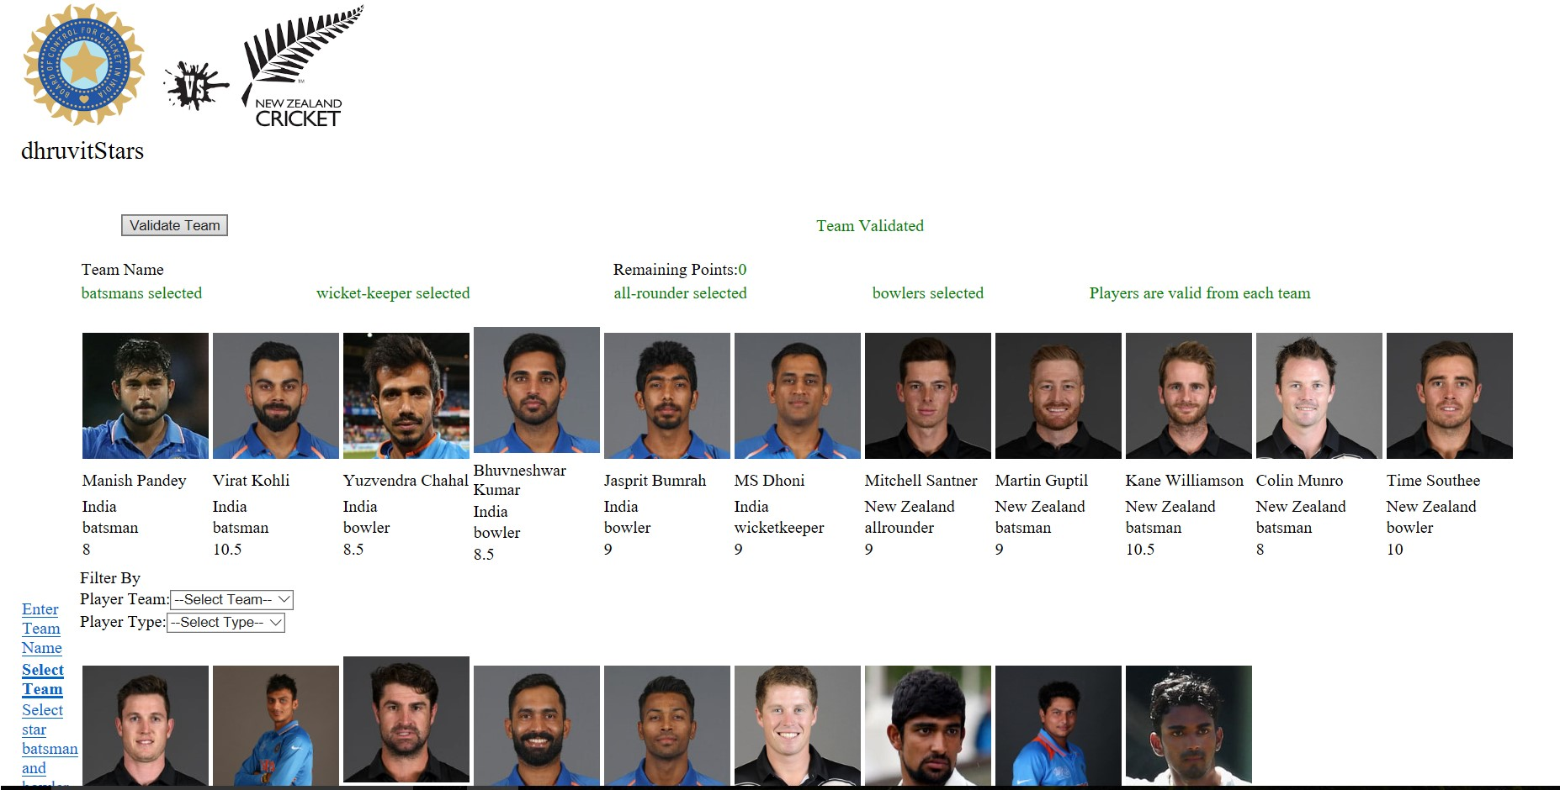
Output Description Team (2)

Slide 26
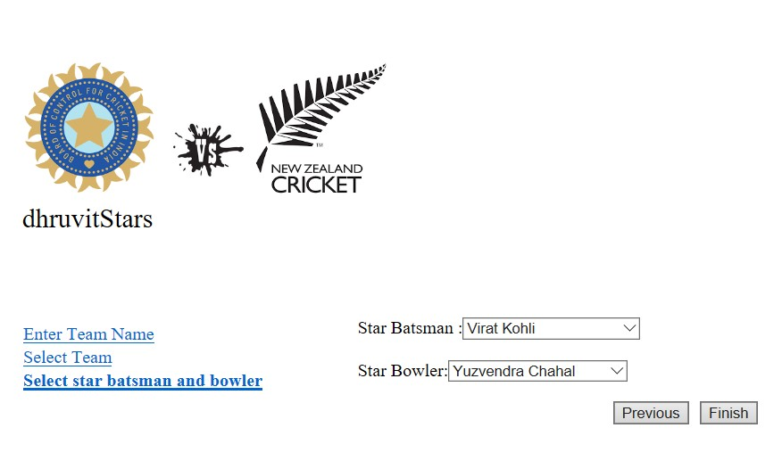
Output Description Team (3)

Slide 27
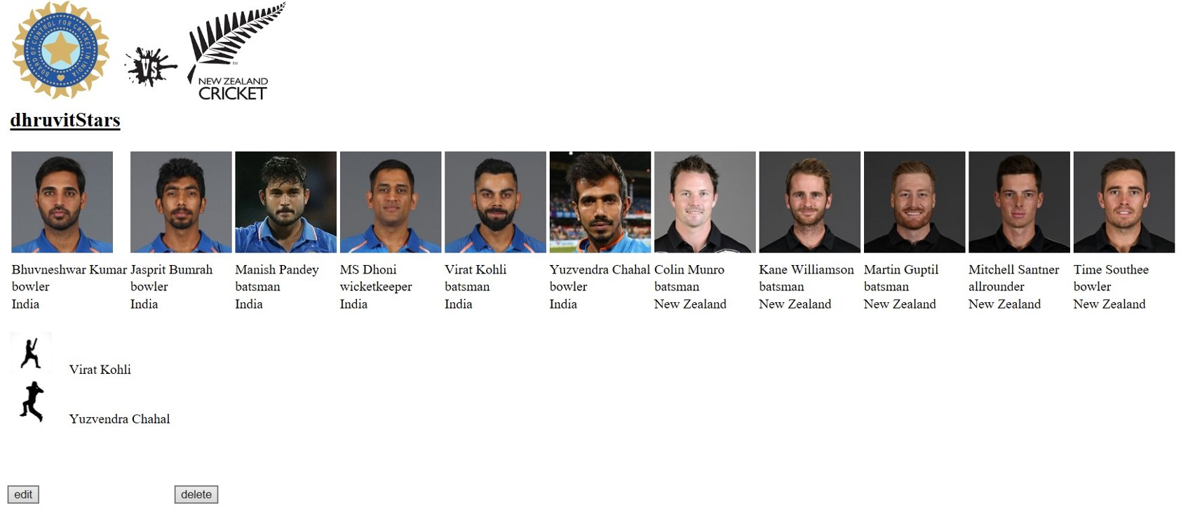
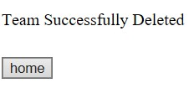
Output Description User-View
Delete

Slide 28
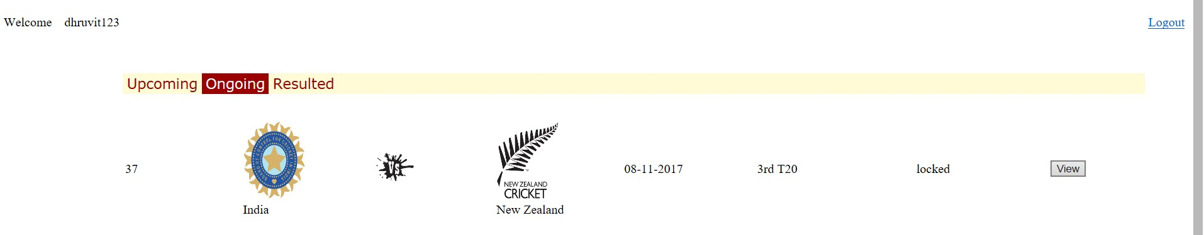
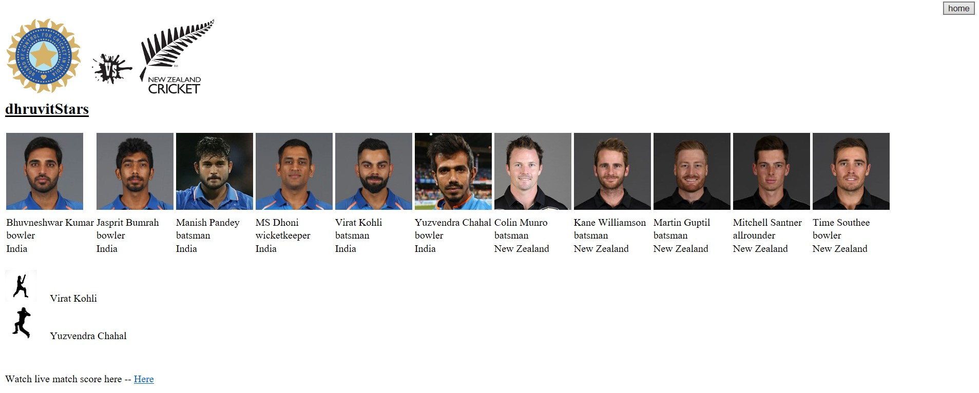
Output Description After Creating Team and Event is locked

Slide 29
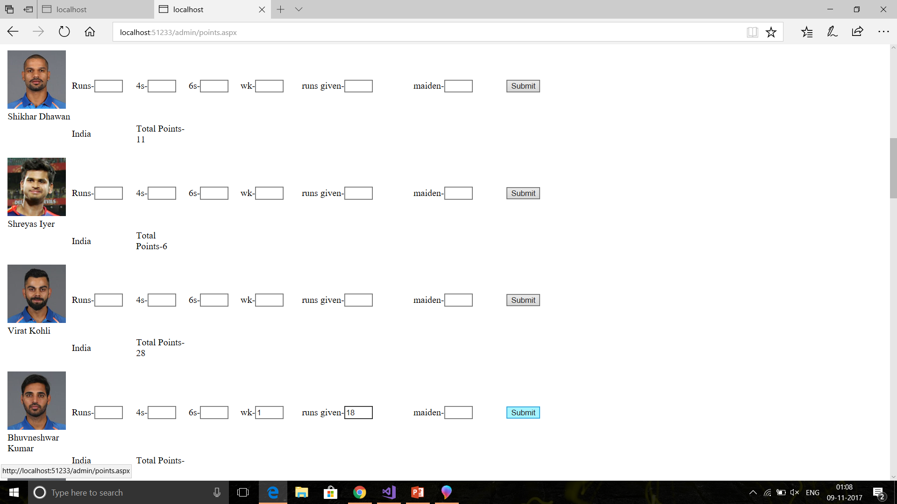
Output Description Admin– Points(1)

Slide 30
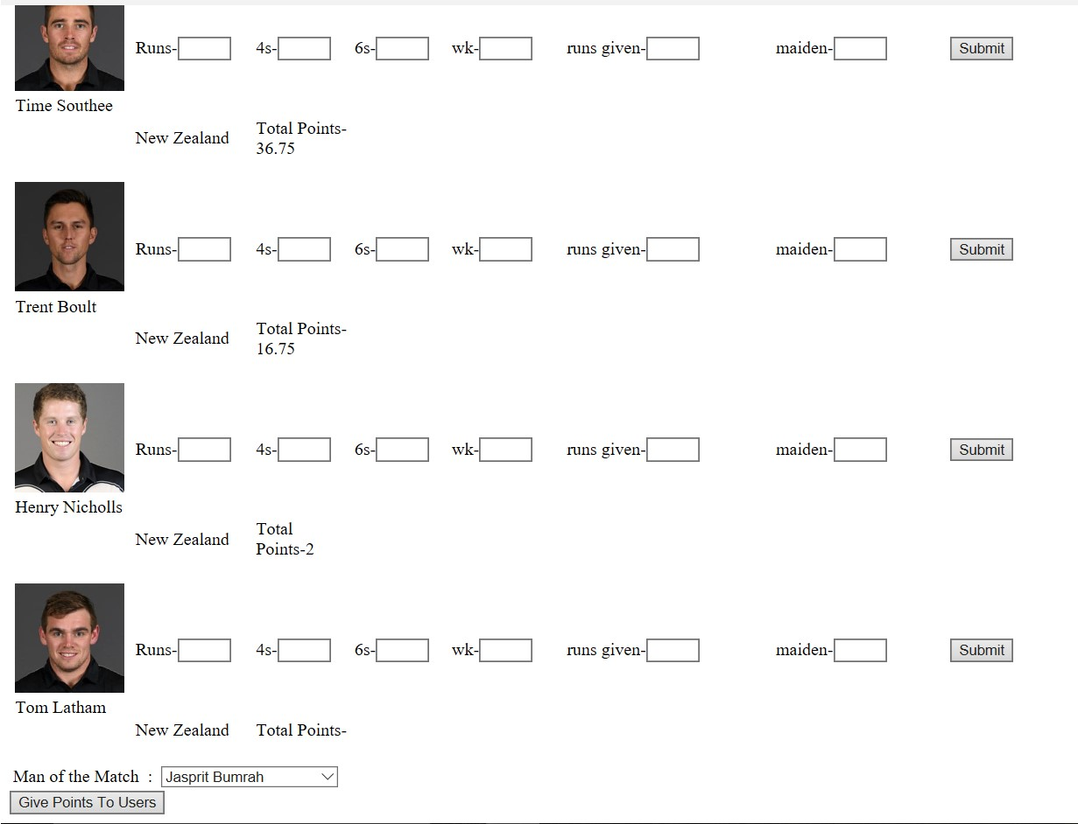
Output Description Admin– Points(2)

Slide 31
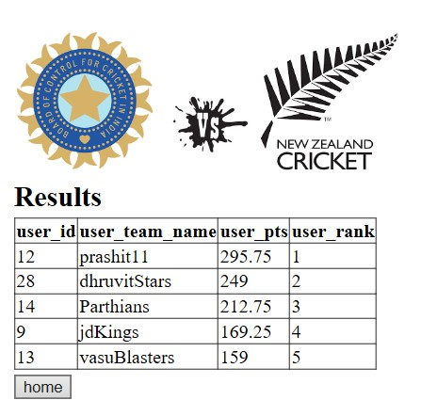
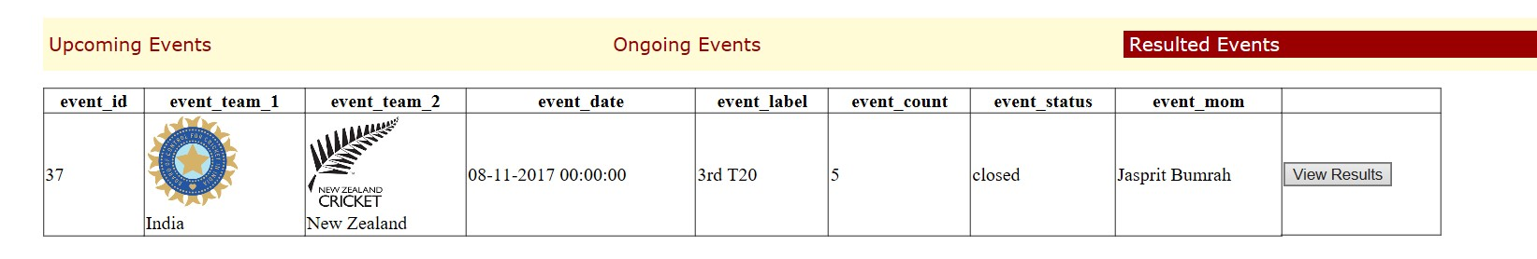
Output Description Admin– CalcResult
Admin– Ahome after calculating
results

Slide 32
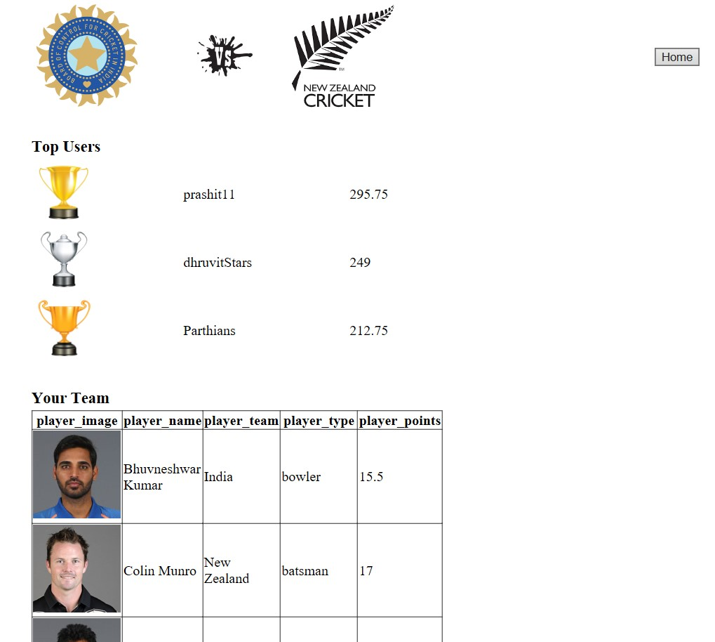
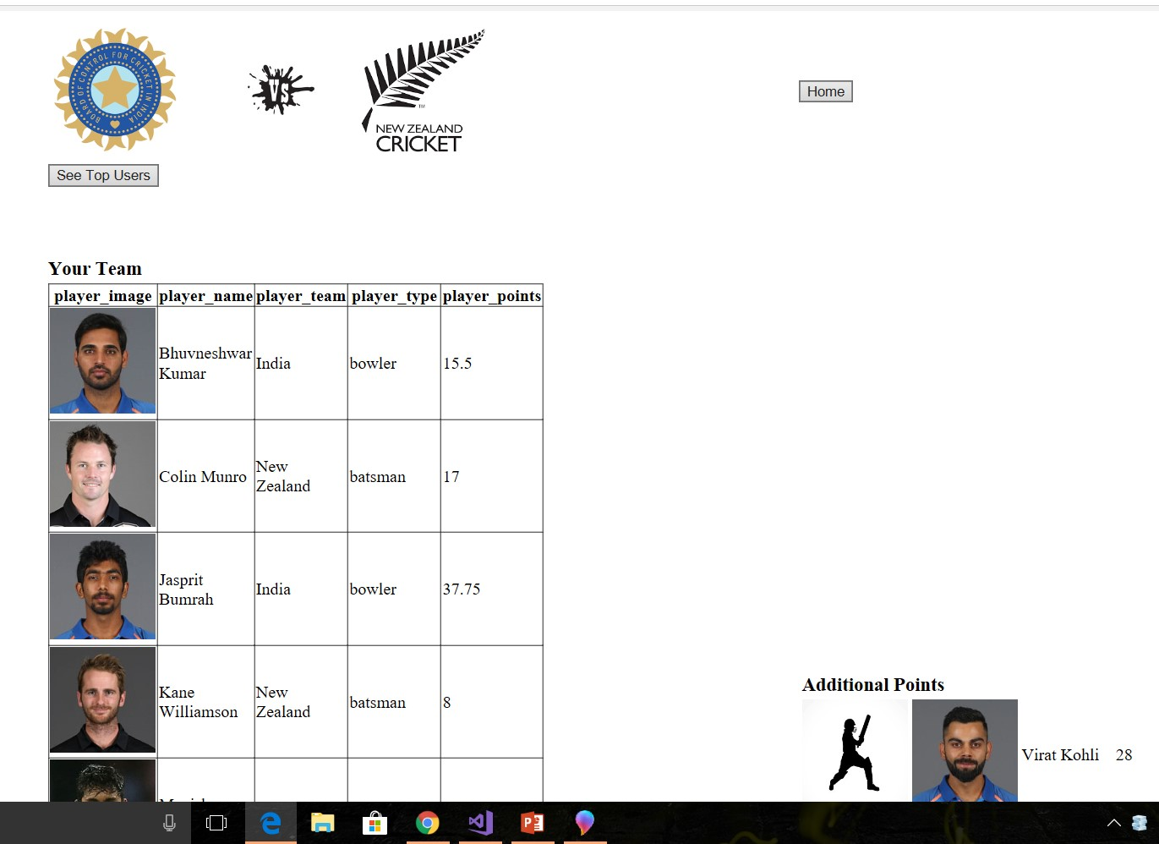
Output Description User – Result(1)

Slide 33
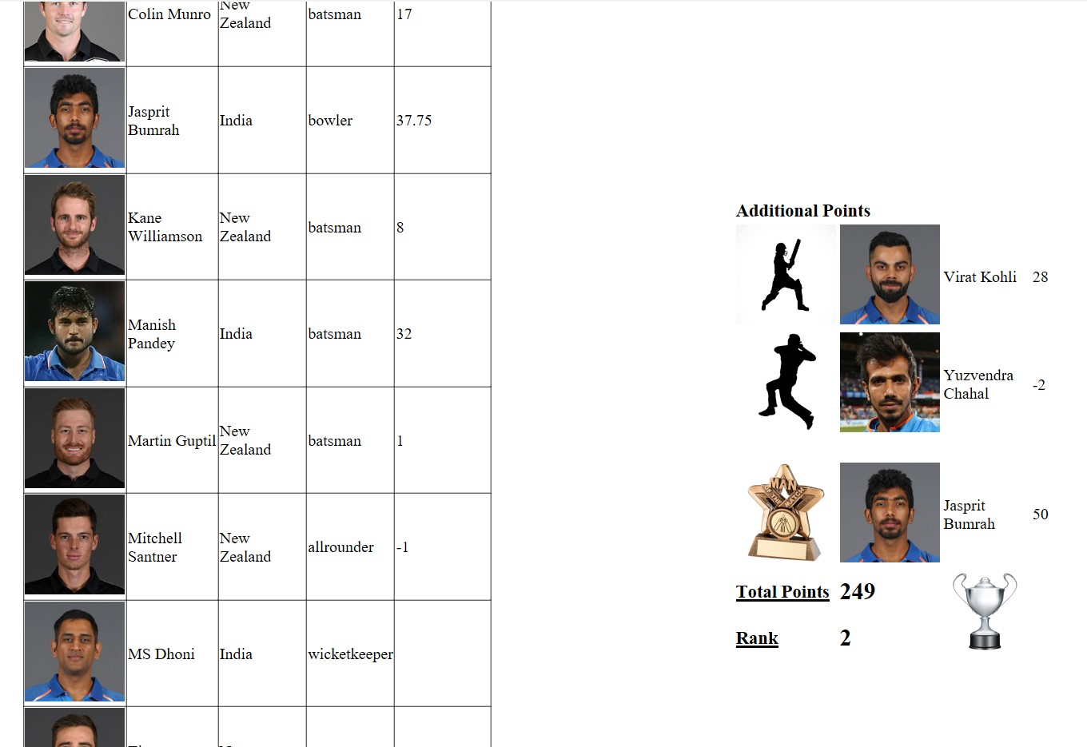
Output Description User – Result(2)

Slide 34
THANK YOU From-Dhruvit Parekh ce 82 Prashit Patel ce 90 Vasu Patel ce 93

